Slide 1










Canonical protein dynamics
Flowchart
Differential equation
$$β$$
$$α$$
$$\frac{dx}{dt}=β−αx$$
$$x$$
φ
$$x\left(t\right)$$
Solution
$$β/α$$
$$t$$
0

Slide 2


Physical picture of protein translation and degradation
No degradation for this copy of protein
No translation
No change
$$t \left(τ_{DICE}\right)$$
0
1
2
3
4
5
6
7
8
9
10
11
12
13
14
15
16
17
18
19
20

Slide 3
Physical picture of protein translation and degradation
Chance translation
+
+
$$t \left(τ_{DICE}\right)$$
0
1
2
3
4
5
6
7
8
9
10
11
12
13
14
15
16
17
18
19
20

Slide 4
Physical picture of protein translation and degradation
Neglected to roll dice on this freshly generated copy of protein
+
No change
+
$$t \left(τ_{DICE}\right)$$
0
1
2
3
4
5
6
7
8
9
10
11
12
13
14
15
16
17
18
19
20

Slide 5
Physical picture of protein translation and degradation
+
No change
+
$$t \left(τ_{DICE}\right)$$
0
1
2
3
4
5
6
7
8
9
10
11
12
13
14
15
16
17
18
19
20

Slide 6

Physical picture of protein translation and degradation
+
+
$$t \left(τ_{DICE}\right)$$
0
1
2
3
4
5
6
7
8
9
10
11
12
13
14
15
16
17
18
19
20

Slide 7
Physical picture of protein translation and degradation
+
Rolled dice for copy of protein that was already degraded!
No change
+
$$t \left(τ_{DICE}\right)$$
0
1
2
3
4
5
6
7
8
9
10
11
12
13
14
15
16
17
18
19
20

Slide 8
Physical picture of protein translation and degradation
+
+
$$t \left(τ_{DICE}\right)$$
0
1
2
3
4
5
6
7
8
9
10
11
12
13
14
15
16
17
18
19
20

Slide 9
Physical picture of protein translation and degradation
+
+
$$t \left(τ_{DICE}\right)$$
0
1
2
3
4
5
6
7
8
9
10
11
12
13
14
15
16
17
18
19
20

Slide 10
Physical picture of protein translation and degradation
Chance translation
+
+
+
+
$$t \left(τ_{DICE}\right)$$
0
1
2
3
4
5
6
7
8
9
10
11
12
13
14
15
16
17
18
19
20

Slide 11
Physical picture of protein translation and degradation
+
+
+
+
$$t \left(τ_{DICE}\right)$$
0
1
2
3
4
5
6
7
8
9
10
11
12
13
14
15
16
17
18
19
20

Slide 12
Physical picture of protein translation and degradation
+
+
+
+
$$t \left(τ_{DICE}\right)$$
0
1
2
3
4
5
6
7
8
9
10
11
12
13
14
15
16
17
18
19
20

Slide 13
Physical picture of protein translation and degradation
+
+
+
+
$$t \left(τ_{DICE}\right)$$
0
1
2
3
4
5
6
7
8
9
10
11
12
13
14
15
16
17
18
19
20

Slide 14
Physical picture of protein translation and degradation
+
+
+
+
$$t \left(τ_{DICE}\right)$$
0
1
2
3
4
5
6
7
8
9
10
11
12
13
14
15
16
17
18
19
20

Slide 15
Physical picture of protein translation and degradation
+
+
+
+
$$t \left(τ_{DICE}\right)$$
0
1
2
3
4
5
6
7
8
9
10
11
12
13
14
15
16
17
18
19
20

Slide 16
Physical picture of protein translation and degradation
+
+
+
+
$$t \left(τ_{DICE}\right)$$
0
1
2
3
4
5
6
7
8
9
10
11
12
13
14
15
16
17
18
19
20

Slide 17
Physical picture of protein translation and degradation
+
+
+
+
$$t \left(τ_{DICE}\right)$$
0
1
2
3
4
5
6
7
8
9
10
11
12
13
14
15
16
17
18
19
20

Slide 18
Physical picture of protein translation and degradation
Chance translation
+
+
+
+
+
+
$$t \left(τ_{DICE}\right)$$
0
1
2
3
4
5
6
7
8
9
10
11
12
13
14
15
16
17
18
19
20

Slide 19
Physical picture of protein translation and degradation
+
+
+
+
+
+
$$t \left(τ_{DICE}\right)$$
0
1
2
3
4
5
6
7
8
9
10
11
12
13
14
15
16
17
18
19
20

Slide 20
Physical picture of protein translation and degradation
+
+
+
+
+
+
$$t \left(τ_{DICE}\right)$$
0
1
2
3
4
5
6
7
8
9
10
11
12
13
14
15
16
17
18
19
20

Slide 21
Physical picture of protein translation and degradation
+
+
+
+
+
+
$$t \left(τ_{DICE}\right)$$
0
1
2
3
4
5
6
7
8
9
10
11
12
13
14
15
16
17
18
19
20

Slide 22


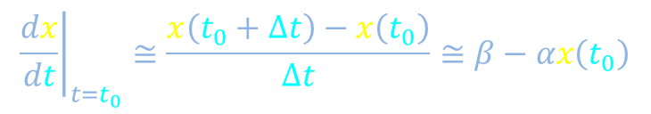

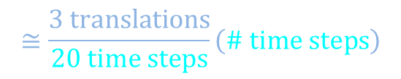


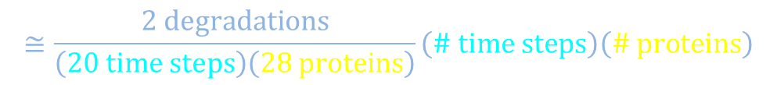


Mathematical description of protein translation and degradation
Between times $t_{0}$ and $t_{0}+∆t$
$$≅\frac{3 translations}{20 time steps}\left(\# time steps\right)$$
$$≅β∆t$$
Proteins added
56
+
28
$$≅\frac{2 degradations}{\left(20 time steps\right)\left(28 proteins\right)}\left(\# time steps\right)\left(\# proteins\right)$$
$$≅α ∆t x\left(t_{0}\right)$$
Proteins lost
+
$$x\left(t_{0}+∆t\right)≅x\left(t_{0}\right)+β∆t−α ∆t x\left(t_{0}\right)$$
$$x\left(t_{0}+∆t\right)−x\left(t_{0}\right)≅β∆t−α ∆t x\left(t_{0}\right)$$
+
$${\left.\frac{dx}{dt}\right|}_{t=t_{0}}≅\frac{x\left(t_{0}+∆t\right)−x\left(t_{0}\right)}{∆t}≅β−αx\left(t_{0}\right)$$
$$∆t$$
$$t_{0}$$
+
+
+
$$t \left(τ_{DICE}\right)$$
0
1
2
3
4
5
6
7
8
9
10
11
12
13
14
15
16
17
18
19
20

Slide 23




Mathematical description of protein translation and degradation
$$\frac{dx}{dt}=β−αx$$
$$β$$
$$α$$
$$x$$
φ
+
Differential equation has limitations
STOP
30
+
Unrealistically
smooth trajectory
29
x (# proteins)
+
Realistic trajectory
28
+
+
+
$$t \left(τ_{DICE}\right)$$
0
1
2
3
4
5
6
7
8
9
10
11
12
13
14
15
16
17
18
19
20

Slide 24
Canonical protein dynamics
Flowchart
Differential equation
$$β$$
$$α$$
$$\frac{dx}{dt}=β−αx$$
$$x$$
φ
$$x\left(t\right)$$
Solution
$$β/α$$
$$t$$
0

Slide 25


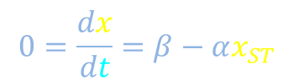



Time-course and rise time
$$\frac{dx}{dt}=β−αx$$
$$β$$
$$α$$
$$x$$
φ
Declare initial condition, for example, “start at time 0 with no protein”
Look for possible steady states
$$0=\frac{dx}{dt}=β−αx_{ST}$$
$$x\left(0\right)=0$$
$$x_{ST}=\frac{β}{α}$$
$$x\left(t\right)$$
Estimate some slopes
$$β/α$$
0
$$t$$

Slide 26





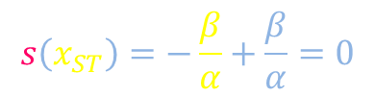







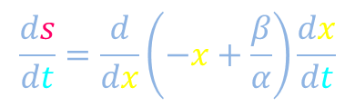
Time-course and rise time
$$\frac{dx}{dt}=β−αx$$
$$β$$
$$α$$
$$x$$
φ
$$\frac{dx}{dt}=α\left(\frac{β}{α}−x\right)$$
$$\int_{s=s\left(x\left(0\right)\right)}^{s\left(x\left(t_{f}\right)\right)}{\frac{1}{s}ds}=−α\int_{t=0}^{t_{f}}{dt}$$
$$s\left(x\right)=−x+\frac{β}{α}$$
$$s\left(x\right)$$
$$s\left(x\left(0\right)\right)=\frac{β}{α}$$
$$−\frac{ds}{dt}=αs$$
$$s\left(x_{ST}\right)=−\frac{β}{α}+\frac{β}{α}=0$$
$$\int_{t=0}^{t_{f}}{\frac{1}{s}\frac{ds}{dt}dt}=−α\int_{t=0}^{t_{f}}{dt}$$
$$\frac{ds}{dt}=\frac{ds}{dx}\frac{dx}{dt}$$
$$\frac{ds}{dt}=\frac{d}{dx}\left(−x+\frac{β}{α}\right)\frac{dx}{dt}$$
$$x\left(t\right)$$
$$β/α$$
$$\frac{ds}{dt}=−\frac{dx}{dt}$$
0
$$t$$

Slide 27



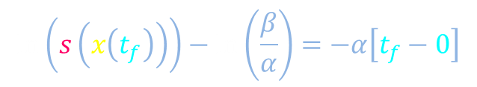
Time-course and rise time
$$\frac{dx}{dt}=β−αx$$
$$β$$
$$α$$
$$x$$
φ
$$\int_{s=s\left(x\left(0\right)\right)}^{s\left(x\left(t_{f}\right)\right)}{\frac{1}{s}ds}=−α\int_{t=0}^{t_{f}}{dt}$$
$$s\left(x\right)=−x+\frac{β}{α}$$
$$s\left(x\left(0\right)\right)=\frac{β}{α}$$
$$\ln\left(\frac{s\left(x\left(t_{f}\right)\right)}{β/α}\right)=−αt_{f}$$
$$\ln\left(s\left(x\left(t_{f}\right)\right)\right)−\ln\left(\frac{β}{α}\right)=−α\left[t_{f}−0\right]$$
$$s\left(x_{ST}\right)=−\frac{β}{α}+\frac{β}{α}=0$$
$$\frac{s\left(x\left(t_{f}\right)\right)}{β/α}=e^{−αt_{f}}$$
$$\frac{ds}{dt}=\frac{ds}{dx}\frac{dx}{dt}$$
$$s=\frac{β}{α}e^{−αt_{f}}$$
$$\frac{ds}{dt}=\frac{d}{dx}\left(−x+\frac{β}{α}\right)\frac{dx}{dt}$$
$$x\left(t\right)$$
$$β/α$$
$$\frac{ds}{dt}=−\frac{dx}{dt}$$
0
$$t$$

Slide 28


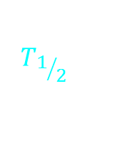












Time-course and rise time
$$\frac{dx}{dt}=β−αx$$
$$β$$
$$α$$
$$x$$
φ
$$s=\frac{β}{α}e^{−αt_{f}}$$
Show
STOP
$$T_{1/2}=\frac{\ln\left(2\right)}{α}$$
$$x\left(t\right)$$
$$β/α$$
$$β/α$$
$$β/α$$
$$β/{2α}$$
$$β/{2α}$$
$$β/α$$
$$β/{2α}$$
$$β/α$$
$$β/{2α}$$
$$β/{2α}$$
0
$$t$$
$$T_{1/2}$$

Slide 29


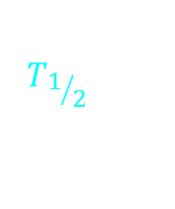

Time-course and rise time
$$\frac{dx}{dt}=β−αx$$
$$β$$
$$α$$
$$x$$
φ
$$s=\frac{β}{α}e^{−αt_{f}}$$
$$T_{1/2}=\frac{\ln\left(2\right)}{α}$$
$$x\left(t\right)$$
$$β/α$$
$$β/{2α}$$
0
$$t$$
$$T_{1/2}$$
$$T_{1/2}$$
$$T_{1/2}$$
$$T_{1/2}$$
$$T_{1/2}$$

